Slide 1
Steps In Bacteria Growth

Slide 2
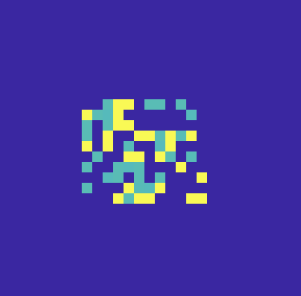
All the simulation are initialized with random data
left picture is an example of one initialization.

Slide 3
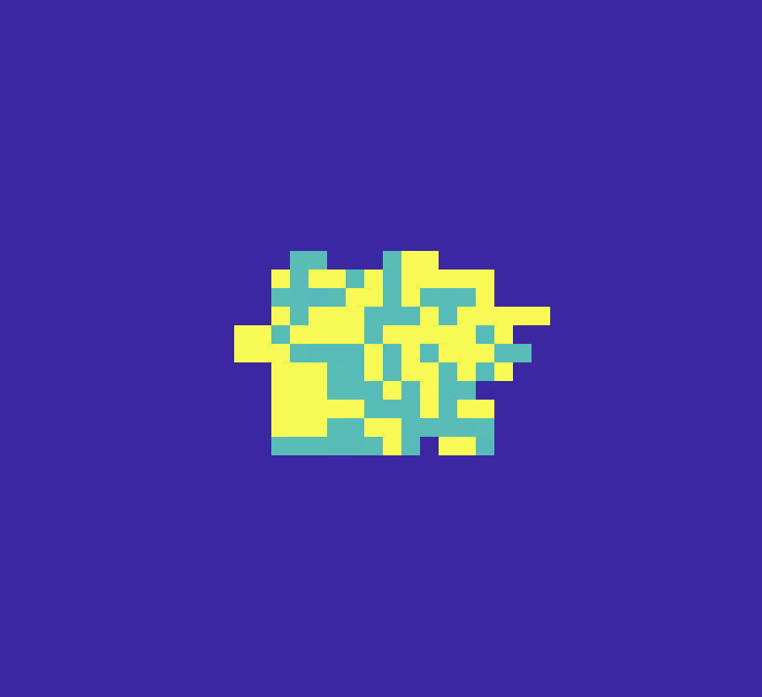
Initially, the cells will fill blank between them.

Slide 4

Branches of 2 types of cells are gradually formed. During the process, some cells will be engulfed by another cell type and some cells will grow into the branch. (Even or odd number of branches doesn’t matter at this case)

Slide 5

Several branches formed previously will continue to grow. Then some branches will smaller growing speed will gradually be engulfed by branches composed with another type of cell. (essential phase which have decisive influence on the later generated pattern)

Slide 6

In engulf pattern, one will eventually engulf another type.

Slide 7

In the end of spiral pattern, (in some cases, there may be more branches) two branches will rotating in the same direction (either counter-clockwise or clockwise).

Slide 8
Whether the pattern will be engulfing, or spiral is randomly happened. Both cases can occur in different parameters. (different diffusion rate of nutrients)

Slide 9
diff20
diff50
diff100
In engulf pattern, the higher the diffusion of nutrient value is, the thicker the outer layer will be. (Do make sense)

Slide 10
More measurement will be generated on spiral speed and thickness of the branches

